Slide 1
Movie Analysis for Microsoft

Slide 2
Business Problem
Microsoft wants to create original video content and are going to create a movie studio.
They are looking for recommendations about what types of films are doing well at the box office in order to decide what types of movies to make.

Slide 3
Business Recommendations
Drama, Action, Comedy, and Adventure movies should receive the most investment for production because they are extremely popular at the box office.
While competitors are also focused on releasing Drama, Action, Comedy, and Adventure movies, the popularity of these genres is high enough that revenues should not suffer due to market competition.
Higher production budgets tend to result in higher revenues, although this is not always and is subject to outside factors.

Slide 4
Data Used
The data that was analyzed came from datasets from IMDB
and Box Office Mojo.

Slide 5
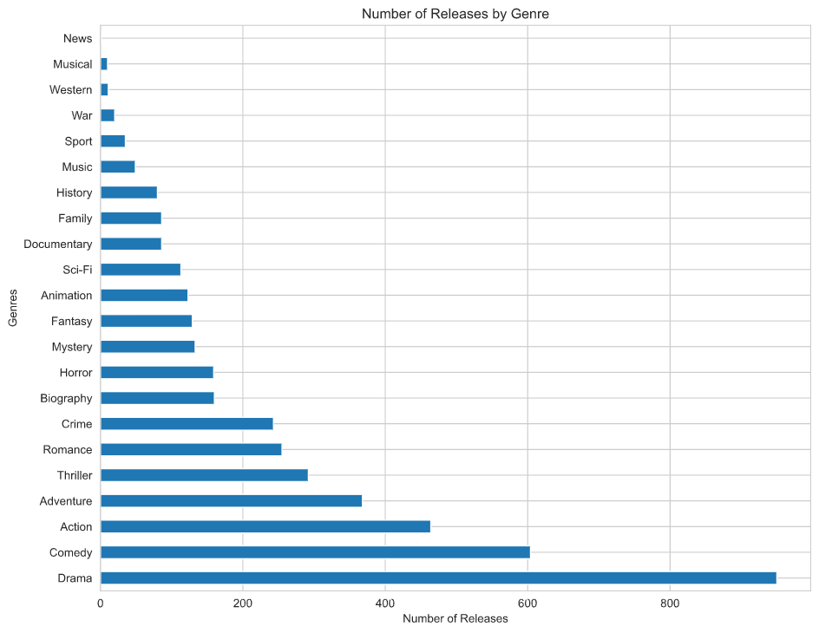
Total number of Releases by Genres
Notes:
-Based on our analysis, the most common genres for movie releases are Drama, Comedy, Action, Adventure

Slide 6
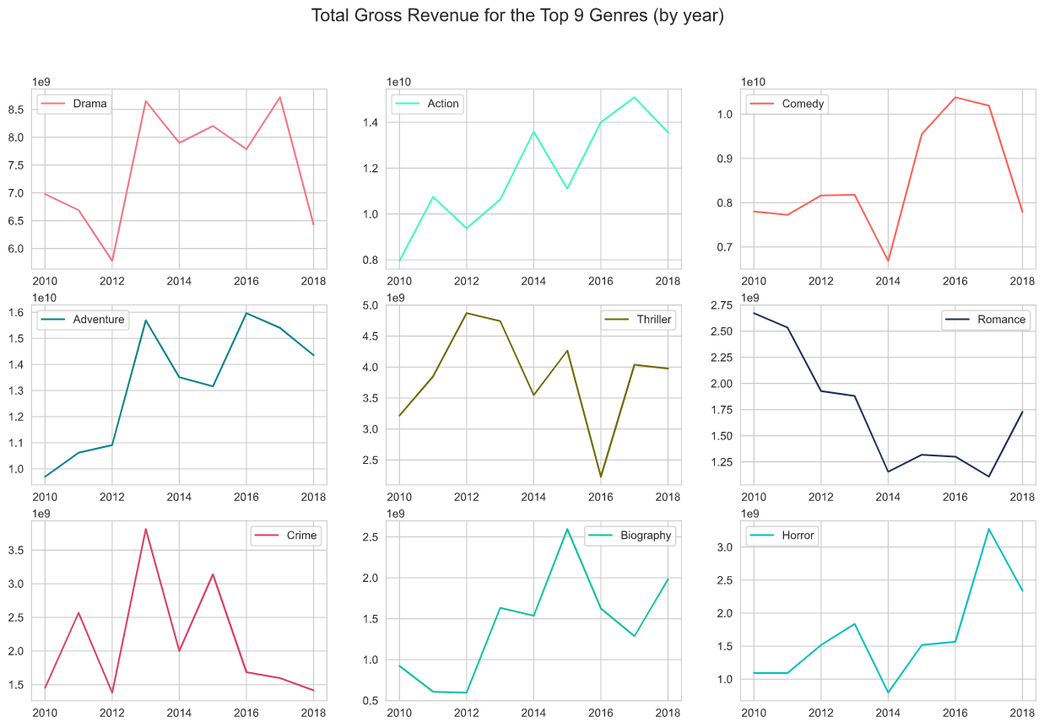
Total Revenues by Genre
Notes:
-Based on our analysis, these are the 9 genres that have the highest gross revenues
-Drama, Action, and Adventure generate the most

Slide 7
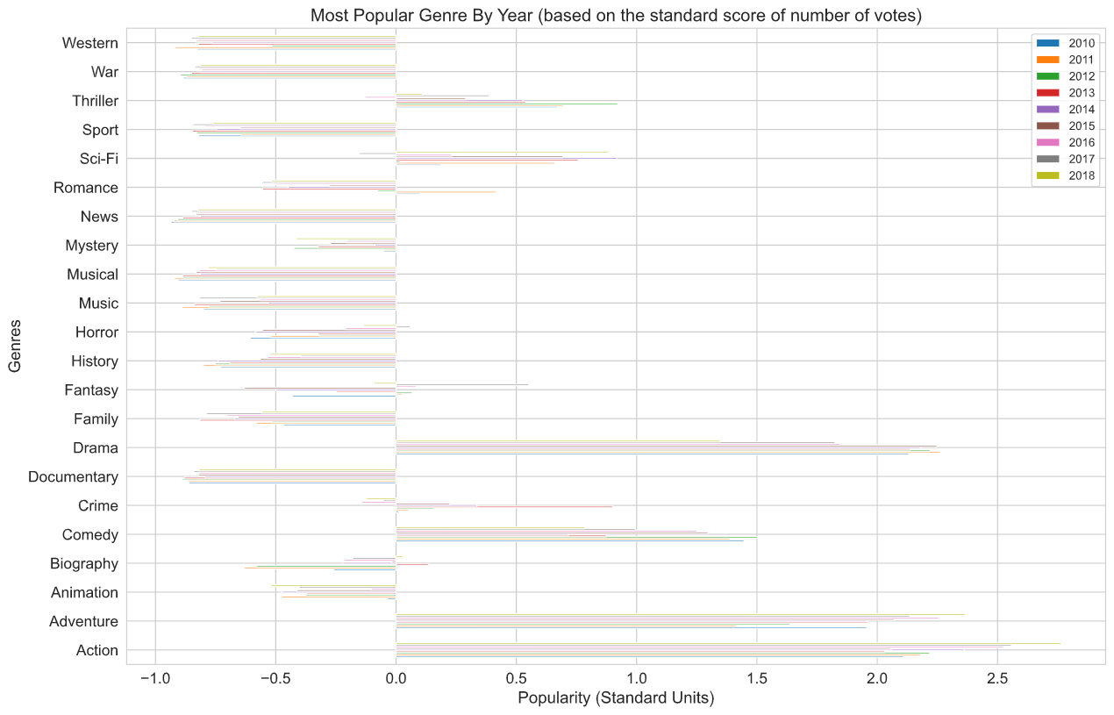
Most Popular Genre by Year

Slide 8
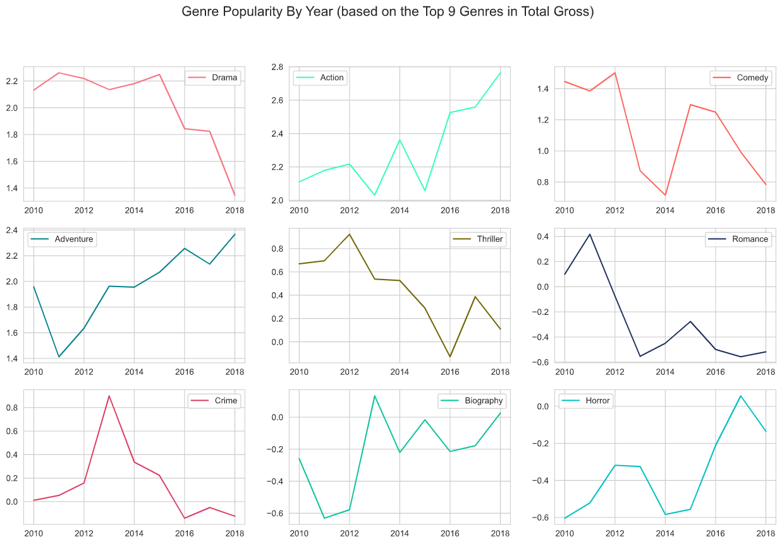

Slide 9
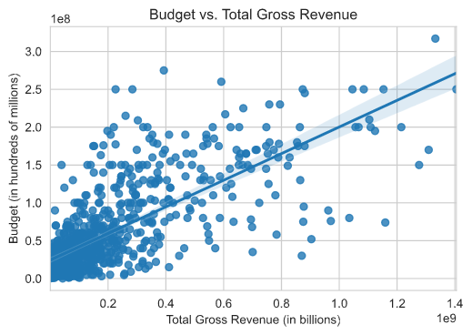
Notes:
-There is a positive correlation between movie budget and gross revenue for a movie

Slide 10
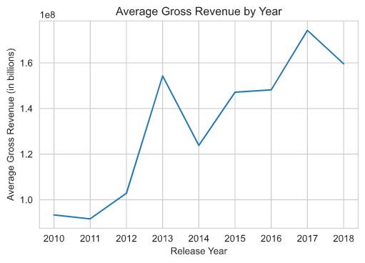
Next Steps
The datasets that were used only cover the period from 2010-2018. More recent data would be helpful to determine current trends.
Additional data on streaming services would be helpful since there has been an increase in popularity of services like Netflix, Amazon Prime, and releases that are exclusive to those platforms that may impact box revenues.
Many movie theaters closed due to COVID-19, so the future of box office revenues is unclear until more data is known about movie revenues after theaters reopen.

Slide 11
Thank you!

